Slide 1
Connecting Amazon GuardDuty to Microsoft Sentinel
Anthony Zatika
1
Notes:
Hello, welcome to my presentation. Today, I will be investigating how companies can utilize the threat detection features of Amazon Web Services (GuardDuty) and pipe a connection to Microsoft’s suite of technologies under Microsoft Sentinel.

Slide 2
Agenda
What is Amazon GuardDuty
What is Microsoft Sentinel
Email Alerts
Extra Possibilities
Next Week’s Ideas
Notes:
So, for the agenda today I will explain all aspects of Amazon GuardDuty and Microsoft Sentinel. I will explain why it is beneficial to pipe data from AWS GuardDuty to Microsoft Sentinel, primarily because Sentinel has superior notification technology. I will then delve into extra possibilities, such as piping data through an API (Application Program Interfrace). I will finally finish up the presentation with my next weeks ideas.

Slide 3


Introduction
Export Threats From One Application To The Other
Get Alerts From One Application Through Notices Found By Another
Integration Of Different Applications For Better Threat Management
3
Notes:
In today’s world with so many security solutions to choose from, it can be difficult to utilize new and emerging features on all platforms. There are simply just too many solutions to choose from. So, if all different tools and solutions can be connected together it would make for a much better security experience. For instance, if a company uses AWS for all of their services, but then wants to utilize Microsoft's Threat Detection algorithms to monitor their services instead of AWS it is as simple of connecting the two platforms together.

Slide 4
Amazon GuardDuty
Intelligent Threat Detection
4
Notes:
So, first I have to dive into Amazon GuardDuty. This platform is an intelligent threat detection workspace.

Slide 5
Amazon GuardDuty
Stop Unauthorized Activity
Enable Continuous Monitoring and Analysis
Simplify Forensics
Compromised Credentials
Unusual Data Access
API Calls from Unknown or Malicious Sources
Metadata, Context of Security Events
Details on Impacted Sources
Root Causes of Suspicious Activity
Notes:
Amazon GuardDuty can stop unauthorized activity. It can spot compromised credentials, unusual data access, and API calls from unknown malicious Sources. GuardDuty can monitor continuously and analyze data traffic through metadata and context security events. Also, GuardDuty simplifies forensics through showing SOC teams the root causes of suspicious activity.

Slide 6
Microsoft Sentinel
Build Next-Generation Security Operations with Cloud and AI
6
Notes:
Next is Azure Sentinel, this is capable of supplying industry leaders with the next-generation of security operations. Sentinel comes with cloud and AI support as well.

Slide 7
Microsoft Sentinel
Collect
Detect
Investigate
Respond
Data
Cloud Scale
Users, Devices Applications, Both On-Premises and in Multiple Cloud Environments
Uncovered Threats
Minimize False Positive
Analytics and Unparallel Threat Detection
To Threats with AI
Hunt Suspicious Activities
To Incidents Rapidly
Automation
Notes:
Azure Sentinel can collect data from cloud environments, users, devices, and even applications in data centers whether it is on-premises or virtually hosted. It can detect threats and minimize false positives. Sentinel can also provide analytics with unparallel threat detections.

Slide 8
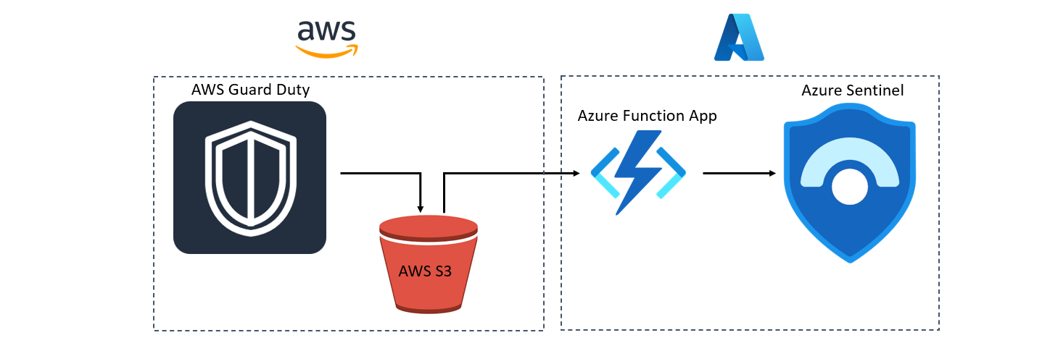
Connecting AWS to Microsoft Sentinel
Configure
Configure AWS Guard Duty and export findings to S3 bucket
Create
Create IAM user with access to S3 bucket and KMS
Deploy
Deploy Microsoft Sentinel Data connector to ingest AWS S3 files
Create
Create Microsoft Sentinel analytics rules to raise incidents based on findings
Notes:
Now, I can entertain the setup of connecting AWS to Microsoft Sentinel. This setup and installation was provided by Marko Lauren who is a senior Cyber Security Technical Specialist at Microsoft. There are four neat steps, number one, configure AWS GuardDuty to export its findings to an S3 bucket instance, number two, create IAM (Identity and Access Management) users to access the S3 bucket, number three, deploy the Azure Sentinel data connector, then finally in number four, create Sentinel analytics to alert when incidents happen. However, I will be using the official Microsoft documents to show how to connect AWS to Microsoft Sentinel (https://docs.microsoft.com/en-us/azure/sentinel/connect-aws?tabs=s3). The reasoning for using the official documents is because it is shorter to setup, and it is the most recommended way to setup the connection.

Slide 9
Steps For Official Method
AWS Environment
Microsoft Sentinel
Configure your AWS service(s) to send logs to an S3 bucket.
Create a Simple Queue Service (SQS) queue to provide notification.
Create an assumed role to grant permissions to your Microsoft Sentinel account (external ID) to access your AWS resources.
Attach the appropriate IAM permissions policies to grant Microsoft Sentinel access to the appropriate resources (S3 bucket, SQS).
Enable and configure the AWS S3 Connector in the Microsoft Sentinel portal. See the instructions below.
Notes:
Before I begin explaining how to setup the connection, I just wanted to note that there are too many technical commands to fit into the presentation. Therefore, after I explain how to setup the connection, I will show everyone the official documentation. Ok, so in this first step we need to configure AWS Guard Duty and export findings to S3 bucket. To achieve this, a KMS key needs to be created created in AWS. Then a Simple Queue Service will need to be created as well to create notifications. There needs to also be a policy where you allow Guard Duty to use the key through IAM permissions and assumed roles. Once that is complete, on the Microsoft Sentinel side, we can enable the official AWS S3 connector to securely transmit the data. All of this can be achieved through automation, Microsoft kindly provides a PowerShell script that can be run on AWS. It is a much easier process. To download the PowerShell scripts, they are available on the official documentation (I can send a link in the chat). However, there is some configurations that need to be made for the automatic script to run correctly.

Slide 10
Automated Script
From the Microsoft Sentinel navigation menu, select Data connectors.
Select Amazon Web Services S3 from the data connectors gallery, and in the details pane, select Open connector page.
In the Configuration section, under 1. Set up your AWS environment, expand Setup with PowerShell script (recommended).
Follow the on-screen instructions to download and extract the AWS S3 Setup Script (link downloads a zip file containing the main setup script and helper scripts) from the connector page.
Before running the script, run the aws configure command from your PowerShell command line, and enter the relevant information as prompted. See AWS Command Line Interface | Configuration basics for details.
Now run the script. Copy the command from the connector page (under "Run script to set up the environment") and paste it in your command line.
The script will prompt you to enter your Workspace ID. This ID appears on the connector page. Copy it and paste it at the prompt of the script.
When the script finishes running, copy the Role ARN and the SQS URL from the script's output (see example in first screenshot below) and paste them in their respective fields in the connector page under 2. Add connection (see second screenshot below).
Select a data type from the Destination table drop-down list. This tells the connector which AWS service's logs this connection is being established to collect, and into which Log Analytics table it will store the ingested data. Then select Add connection.
Notes:
To use the automated script, you need to first go to Microsoft Sentinel and select the Data Connectors tab. Select the AWS S3 from the menu and open the connection page. From there, in the configuration section, select option number one which will be called “setup your AWS environment” and click “setup with PowerShell script.” Proceed to follow the on-screen instructions and download the AWS S3 setup script. Make sure that you run the AWS configure command before the script so that all necessary functions are configured. After that, run the script by copying the necessary command from the connectors page. When prompted, enter your workspace ID. After the script has finished, copy your role ARN and SQS URL and paste them into the connection fields on AWS. Last, click on add connection on that same screen and select the data type destination table from the drop-down list. Save this selection by clicking “add connection.“ It allows the logs to be sent to Microsoft Sentinel through the connection that was just established. Congratulations, the setup is complete.

Slide 11
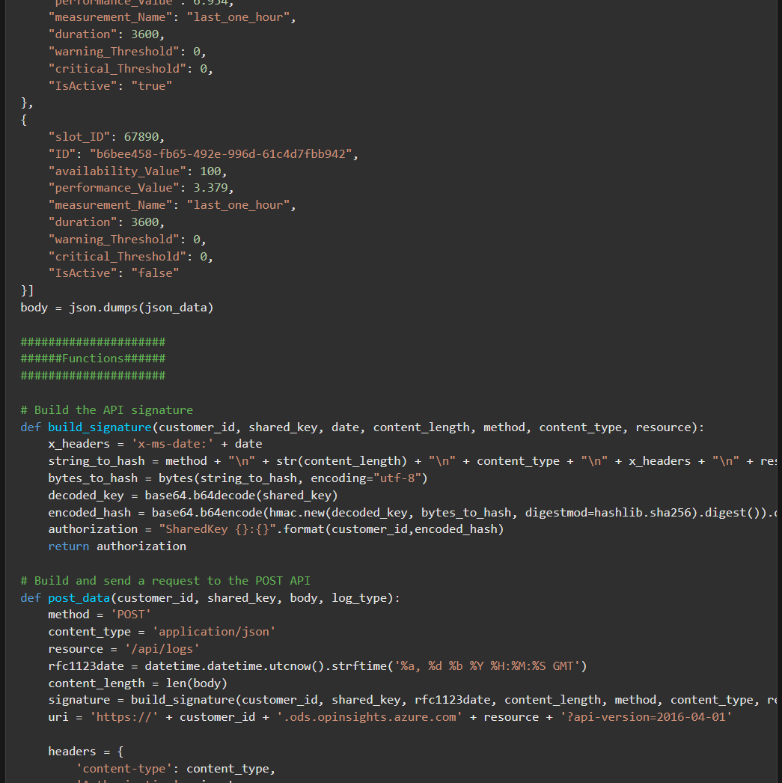
Connecting AWS Through API Ideas
Notes:
Now, just as an idea what happens if you are running a Lambda Machine Learning instance and want to connect that to Microsoft Sentinel. This is a bit complex and requires custom coding to achieve this. I have reviewed the HTTP Data Collector API that Microsoft provides, and it is fairly easy to understand. The only caveat is that you would need to know either Python, C#, Java or PowerShell (MS DOS) to interface with the API. Here is the link for this as well (https://docs.microsoft.com/en-us/azure/azure-monitor/logs/data-collector-api).

Slide 12


Summary
Connecting to Microsoft Sentinel from AWS is surprisingly easy. The automated script takes care of the heavy lifting. Also, if your application needs to interface directly with Microsoft Sentinel, it is easy as long as you are a programmer and know one of the languages (Java, Python, C#).
Notes:
In summary, connecting to Microsoft Sentinel from AWS is surprisingly easy. The automated script takes care of the heavy lifting. Also, if your application needs to interface directly with Microsoft Sentinel, it is fairly easy as long as you are a programmer and know one of the languages (Java, Python, C#).

Slide 13
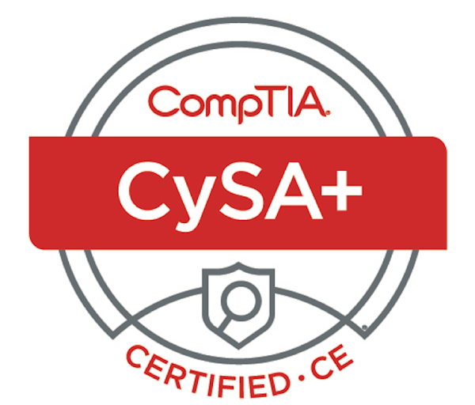
Next Week’s Ideas
ISO 17024
Directive 8570.01-M
Leverage intelligence and threat detection techniques
Analyze and interpret data
Identify and address vulnerabilities
Suggest preventative measures
Effectively respond to and recover from incidents
“CompTIA CySA+ meets the ISO 17024 standard and is approved by U.S. Department of Defense to fulfill Directive 8570.01-M requirements. It is compliant with government regulations under the Federal Information Security Management Act (FISMA)” (comptia.org, n.d).
Notes:
For next week’s ideas I was thinking of taking the information that I have learned from successfully completing and passing the Cybersecurity Analyst Certification exam and create a presentation on the rules and regulations of ISO 17024. Another idea is that I can do a demonstration on how I can get the two methods that I talked about in this presentation working.

Slide 14
Thank You
Anthony Zatika
Notes:
This concludes my presentation, thank you.

Slide 15
References
Azure sentinel – cloud-native siem solution: Microsoft Azure. Azure Sentinel – Cloud-native SIEM Solution | Microsoft Azure. (n.d.). Retrieved July 25, 2022, from https://azure.microsoft.com/en-us/services/microsoft-sentinel/#features
Bwren. (n.d.). Azure Monitor HTTP Data Collector API - Azure Monitor. Azure Monitor HTTP Data Collector API - Azure Monitor | Microsoft Docs. Retrieved July 25, 2022, from https://docs.microsoft.com/en-us/azure/azure-monitor/logs/data-collector-api
Intelligent threat detection - amazon guardduty - amazon web services. (n.d.). Retrieved July 25, 2022, from https://aws.amazon.com/guardduty/
Lauren, M. (2021, November 19). Ingesting AWS guard duty findings to Azure Sentinel. LinkedIn. Retrieved July 25, 2022, from https://www.linkedin.com/pulse/ingesting-aws-guard-duty-findings-azure-sentinel-marko-lauren/
Yelevin. (n.d.). Connect Microsoft Sentinel to Amazon Web Services to ingest AWS Service Log Data. Microsoft Docs. Retrieved July 25, 2022, from https://docs.microsoft.com/en-us/azure/sentinel/connect-aws?tabs=s3

